Slide 1
Capstone Project – 4 Unsupervised Learning
Netflix Movies and TV-Shows Clustering Presented by: Ashutosh Sharma Kumar Aman Prashant Gour Jyotsana Gour Anuj Gupta

Slide 2

Content
Some Facts about Netflix
Understanding The dataset
Eda
Data Cleaning and
Feature Engineering
Pre-processing
Model building
Model Explainability
Conclusion

Slide 3

Some Facts of Netflix
Netflix was Founded in 1997 and its first service was Subscription based DVD by email.
By the End of 2021 Netflix Crossed over 200 Million subscribers WorldWide
Netflix holds 35% of the global OTT streaming share and is undoubtedly the leading OTT provider.
Netflix revenue for the quarter ending September 30, 2022 was $7.926B, a 5.91% increase year-over-year.
Top Competitors of Netflix Include Disney+ Hotstar, Amazon Prime, HBO, Sling TV, Paramount+ and Youtube. All Giants.
In 2006, Netflix launched a $1 million competition to build a Recommender System
Netflix has 223.09 Million Subscribers as of the third quarter of 2022.
Norway has highest percentage population a whelming 36.59%, with Netflix Subscription. And USA as the highest number of Subscribers around 67 Million.
src- Netflix-Annual report 22, statista.com, Wikipedia, CNBC

Slide 4
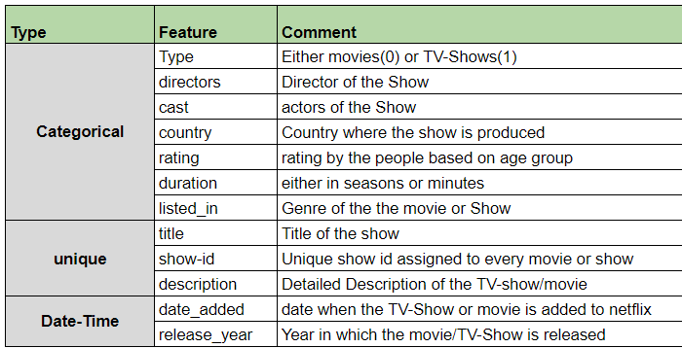
Data Summary & Data Understanding
Data Includes.
* Copy of NETFLIX MOVIES AND TV SHOWS CLUSTERING.csv
A total of we have 7787 rows and 12 columns in our data set.
Features like Director and cast contains 30.7% and 9% missing values respectively. Other features having null values include Country, Date_added and rating
Few outliers were also present in date_added and released_date.
No Duplicates were present.
All features were object-type except only one (release_year)

Slide 5
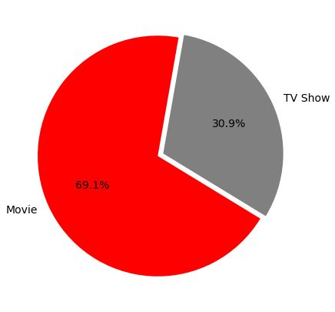
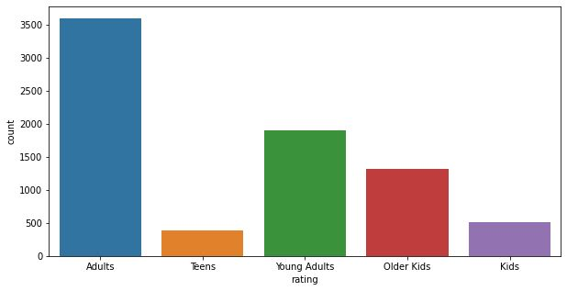
Exploratory Data Analysis :
Que1:Type of content available on Netflix.
Que2: Ratings of movies and tv-shows on Netflix.
Key-takeaways:
In our dataset we have around 69% content as movies
Remaining 31% as TV shows.
Here we have more numberes of Movies than TV shows.
Key-takeaways:
Highest number of shows on Netflix are rated by TV-MA, followed by TV-14 and TV-PG.

Slide 6
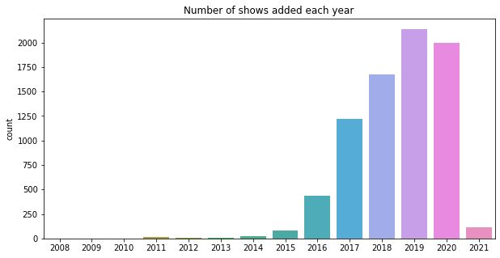
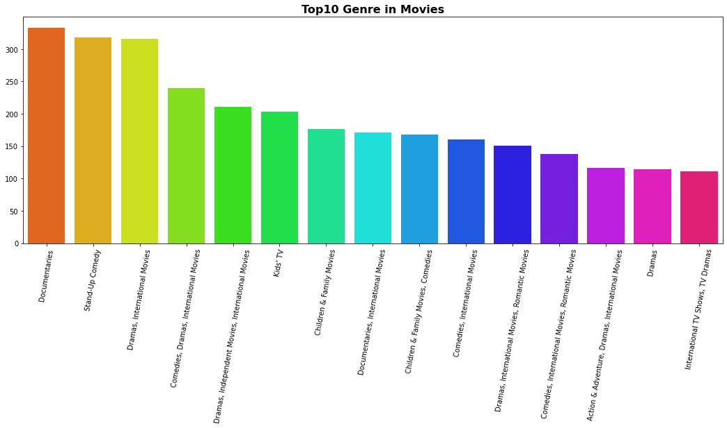
Que3: Top 15 genres on Netflix
Que4: Number of shows added over the
years
Key-takeaways:
Documentaries is the topmost genre available on Netflix. On second position we have Stand-up comedy and Dramas.
Key-takeaways:
The number of release have significantly increased after 2015.
We have highest number of release in the year 2019.
Release have dropped in 2021 becase of Covid 19.

Slide 7
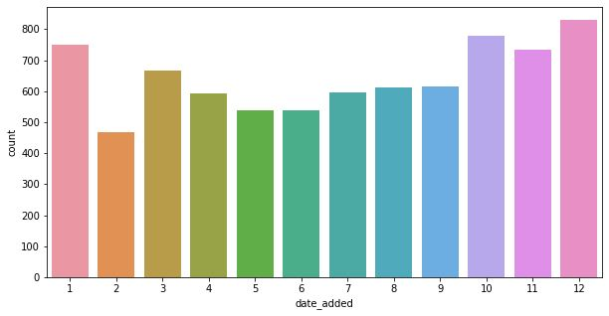
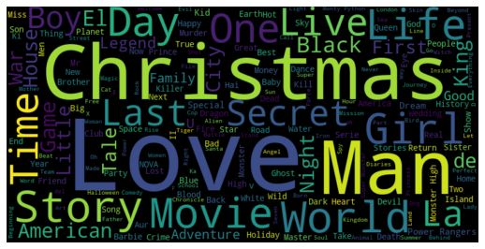
Que.5: Release month of different content
on Netflix
Que.6: Most used word in title of content on Netflix
Key-takeaways:
Maximum number of movies and tv-shows were added from October to January
Key-takeaways:
With the help of word cloud we can notice that the most used word in the title of content are- ‘Love’, ’Christmas’, ’World’, ’Story’, ‘Man’, ‘Live’ ,’Girl’ , ‘Life’

Slide 8
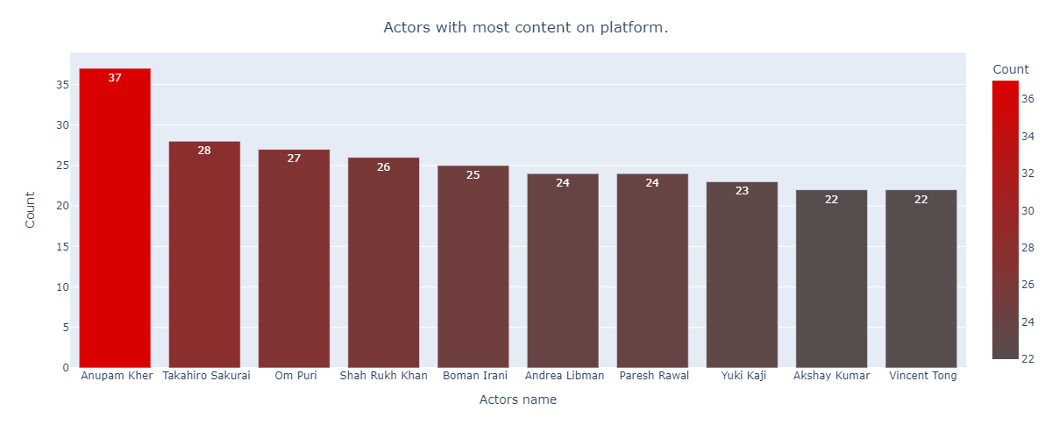
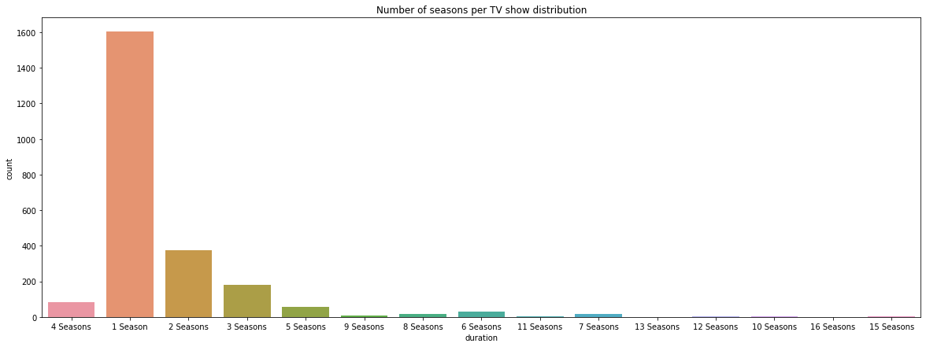
Que.7: Frequent Cast on Netflix
Que.8:Number Of Seasons Of TV-Shows
Key-takeaways:
Top actors on Netflix are-
Anupam Kher
Takahiro Sakurai
Shah Rukh Khan
Om Puri
Key-takeaways:
Most of the tv-shows have only 1 Season.
The TV series in the dataset have up to 16 seasons.
There are very few TV shows that have more than 8 seasons.

Slide 9
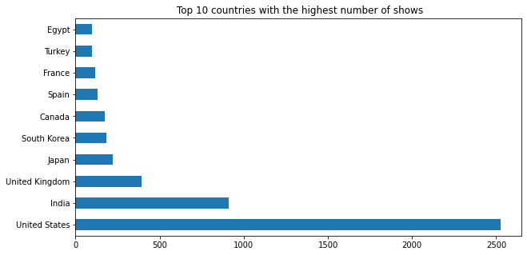
Que.9:Top 10 countries with the highest number movies / TV shows on Netflix
Key-takeaways:
The highest number of movies / TV shows were based out of the United States, followed by India and United Kingdom..

Slide 10
Data Preprocessing
Steps
Casting of feature type from categorical to numeric
Removed unwanted spaces.
Converted all text features to lower case.
Applied count_vectorizer to cast, genres, country.
Removed tabulation and punctuation.
Removed stopwords.
Applied lemmatization.
Created a tfidf vector
Applied MinMax Scaling on Type and Rating.
Created final data frame.

Slide 11
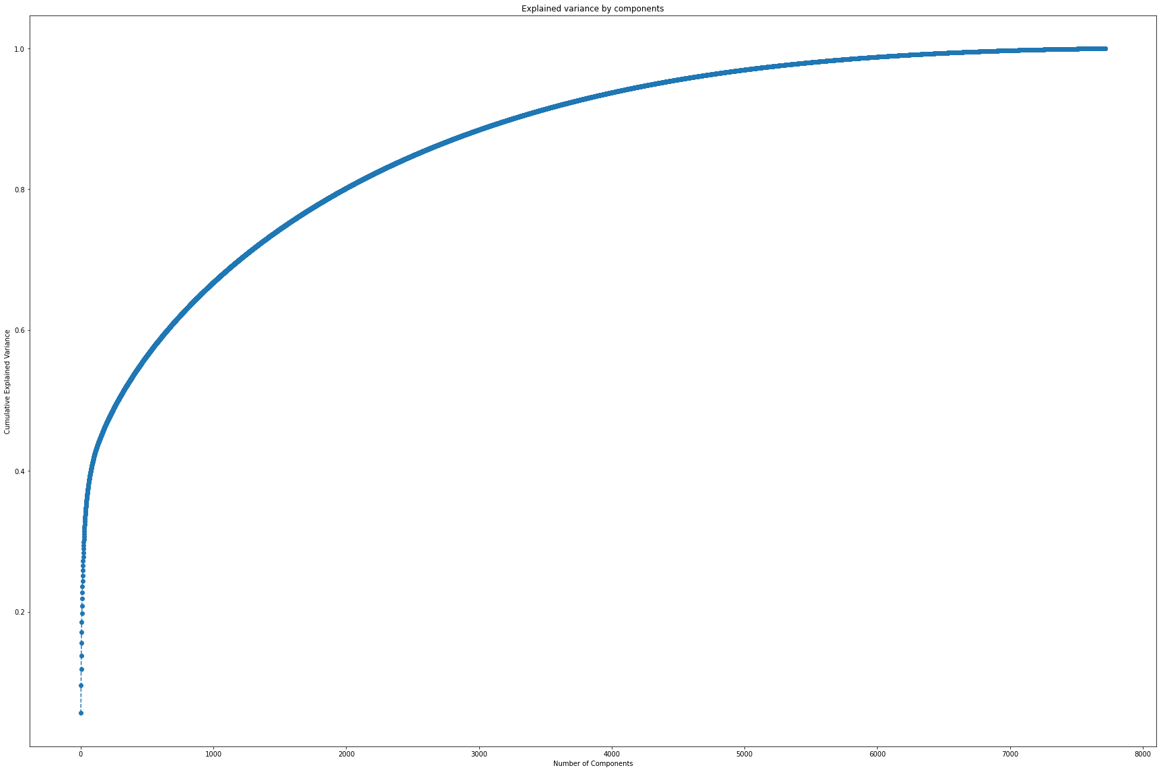
Applying PCA on the Data Frame
The graph shows the amount of variance captured (on the y-axis) depending on the number of components we include (the x-axis). A rule of thumb is to preserve around 80-85 % of the variance. So, in this instance, we decide to keep 3000 components.

Slide 12
Model Building:
KMeans Clustering
Agglomerative Hierarchical Clustering
DBSCAN Clustering

Slide 13
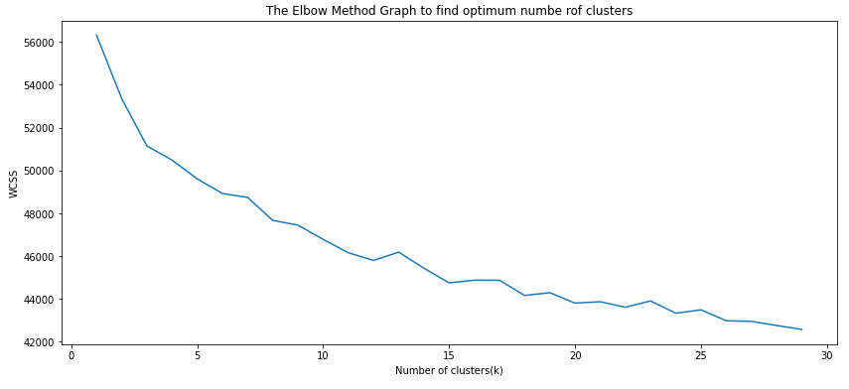
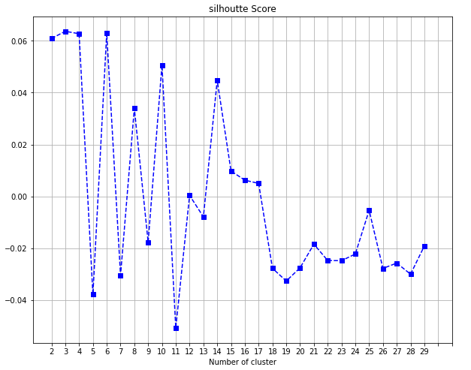
K-means Clustering
Elbow Plot
Silhoutte Score plot

Slide 14
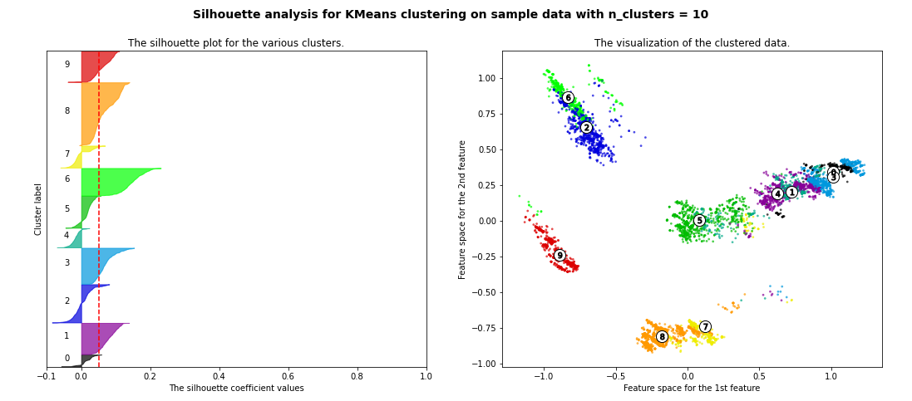
Visualizing Cluster Graph with 10 clusters

Slide 15
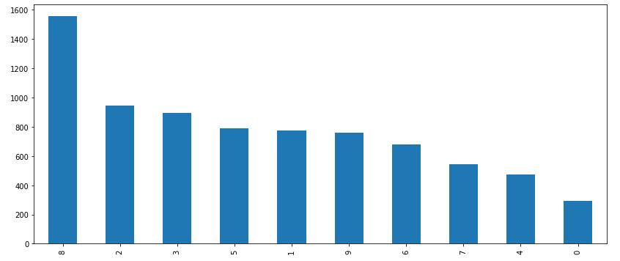
Data Distribution in Clusters of KMeans

Slide 16
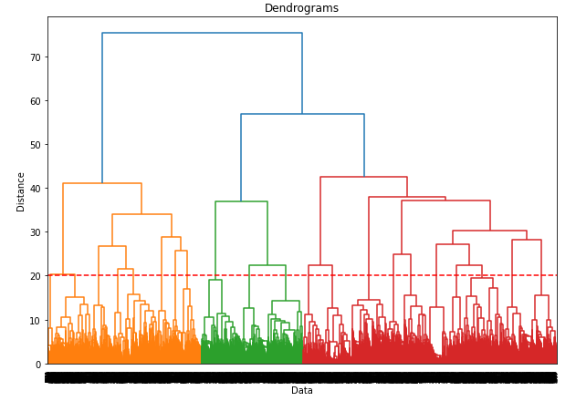
Agglomerative Hierarchical Clustering

Slide 17
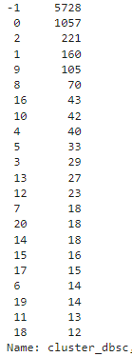
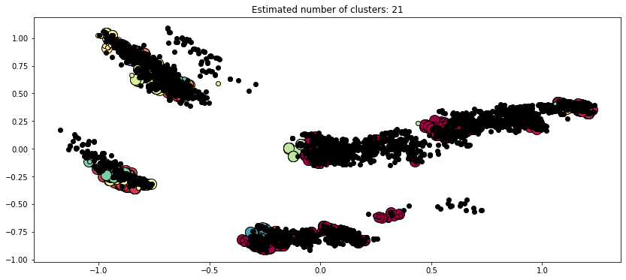
DBSCAN Clustering
Cluster number and assigned number of clusters
Eps = 1.5, clusters_assigned = 21

Slide 18
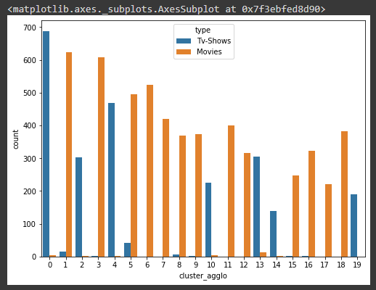
Models Evaluation Conclusion
More precise and separate clusters can be seen in KMeans Clustering
DBSCAN shows overlapping of data points in various clusters.
Estimated number of clusters: 19
Estimated number of noise points: 7134
Most of more than 80% data is grouped in -1 cluster in DBSCAN.
Agglomerative Hierarchical shows 3 larger groups and overlap of data record
Assignment of data records in various clusters on Agglomerative based on Type

Slide 19
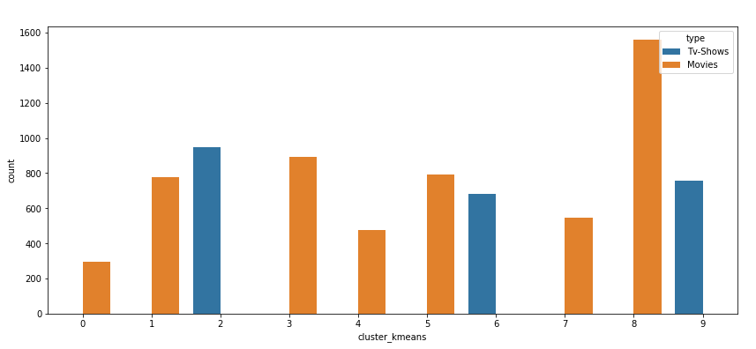

Assignment of data records in various clusters on KMeans based on Type

Slide 20
Classification Model
Build a SVM Classification Model for Classification of Kmeans Cluster labels
Used Grid Search CV with given parameter grid
param_grid = {'C': [0.1, 1, ], 'gamma': [1, 0.1, ], 'kernel': ['rbf','sigmoid','linear']}
A total 60 folds were trained and best estimater was
(C=1, gamma=1, kernel='linear')
Achieved a excellent best accuracy of 99.62 %

Slide 21
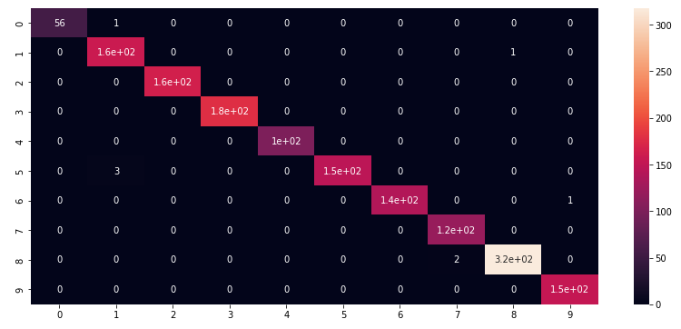
Classification Model
Confusion Matrix of the Model

Slide 22
Conclusion
In this project, we worked on a text clustering problem wherein we had to classify/group the Netflix shows into certain clusters such that the shows within a cluster are similar to each other and the shows in different clusters are dissimilar to each other. The dataset contained about 7787 records, and 11 attributes.
Outlier detection and removal techniques were performed to, on date added and released date feature which are kind correlated feature( 61 outliers removed from date_added feature)
In our dataset we have around 69% content as movies, Remaining 31% as TV shows, this signifies people generally prefer movies over TV-Shows.
Most content on Netflix is rated for Mature Audiences and over 14 years old.
Documentaries is the topmost genre available on Netflix, followed by Stand-up and Drama
From year 2015 there was a significant rise in the rate of making of TV -shows but in 2021 this trend discontinued due to pandemic situation by covid-19 and further the data is not available.
In this project, we worked on a text clustering problem wherein we had to classify/group the Netflix shows and movies into certain clusters such that the shows and Clusters within a cluster are similar to each other and the shows in different clusters are dissimilar to each other.
It was found that Netflix hosts more movies than TV shows on its platform, and the total number of shows added on Netflix is growing exponentially. Also, majority of the shows were produced in the United States, and the majority of the shows on Netflix were created for adults and young adults age group.

Slide 23
Conclusion Contd…
It was decided to cluster the data based on the attributes: director, cast, country, genre, and description. The values in these attributes were tokenized, pre-processed, and then vectorized using TFIDF vectorizer.
Through TF-IDF Vectorization, we created a total of 20000 attributes.
We used Principal Component Analysis (PCA) to handle the curse of dimensionality. 3000 components were able to capture more than around 90% of variance, and hence, the number of components were restricted to 3000.
We first built clusters using the k-means clustering algorithm, and the optimal number of clusters came out to be 10 with good WCSS Value and high silhoutte score of 0.0483. This was obtained through the elbow method and Silhouette score analysis.
Then clusters were built using the Agglomerative clustering algorithm, and the optimal number of clusters came out to be 20 at distance 20. This was obtained after visualizing the dendogram.
DBSCAN cluster didn't gave satisfying results. it was a kind of biased model which was clustering most of the data into a single cluster.
Build a SVM Classification model with hyperparamater tuning at the end to predict a cluster number for a data record.
Classifier predicts good result with above 99% accuracy

Slide 24
Thank You

